Slide 1
Phone Directory
1
Submitted by:
Kritika Pandey
Anusha Shrestha
Bidhya Adhikari
Submitted to:
Department of Computer
and Electronics Engineering
2
3
4
5

Slide 2
Topics Covered:
Project Description
Operations
Implementation of DSA in Project
Project Execution

Slide 3
Project Description
A Phone Directory is a file which performs listing of contacts (name, number, etc) of any personal.
In the same way, this Phone Directory stores the name and number of various persons in alphabetical order and also enables the user to delete the contact.

Slide 4
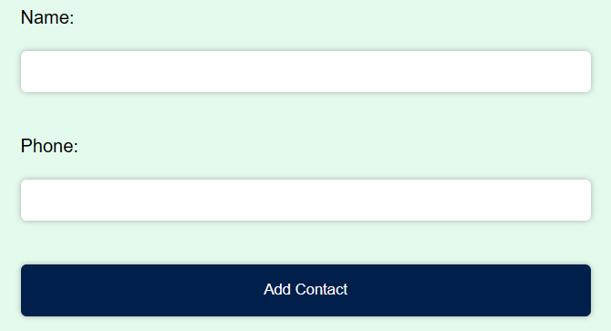

Operations
Add Contacts:
It accepts the input i.e. name and number provided by the user and stores temporarily.
Then, the provided contacts i.e. name and number be sorted in ascending order by name.
Delete :
It deletes the desired contact from the existing sorted list of contacts.

Slide 5
Implementation of DSA
INSERTION SORTING
First of all, Sorting is the process of arranging a collection of items or data in a specific order, often either in ascending or descending order.
Insertion sort is a sorting algorithm that sorts an array of elements by iteratively inserting each unsorted element into its proper sorted position within the array.

Slide 6
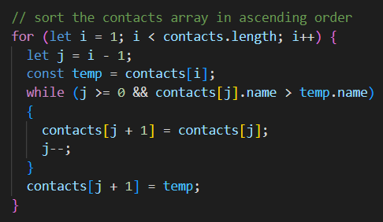
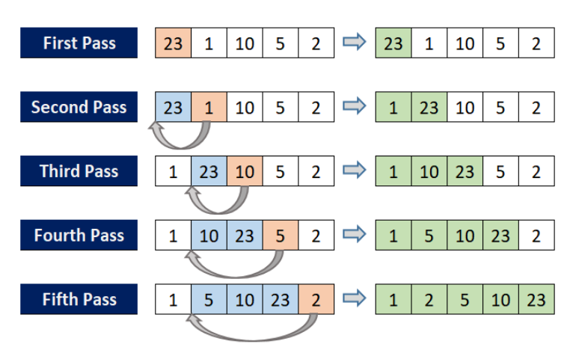
More on Insertion Sort….
Algorithm:
step 1: If it is the first element ,it is already sorted, return 1.
step 2: Pick next element.
step 3: Compare the current element with the sorted portion of the array.
step 4: If the current element is smaller than the previous element, move the previous element one position to the right.
step 5: Insert the value.
step 6: Repeat until list is sorted.

Slide 7
THANK YOU !!!

